Slide 1
CCGC 5004 Database Systems
How to design a database

Slide 2
Objectives
Basic steps to design a data structure
Identify data elements
Sub divide data elements
Identify tables and assign columns
Identify primary and foreign keys
Enforce relationships between tables
How normalization works
Apply normal forms 1NF through 3NF
Use MySQL Workbench for database design
Create EER models with MySQL Workbench

Slide 3
Introduction
Database are often designed by database administrators (DBAs) or design specialists
Especially true for large, multiuser databases
How well a database is designed can affect your job as a SQL programmer
Well designed database is easy to understand and query
A poorly deigned database is difficult to work with

Slide 4
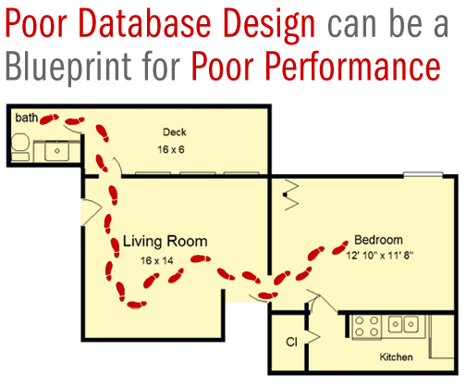
Is Anything Wrong with This?

Slide 5
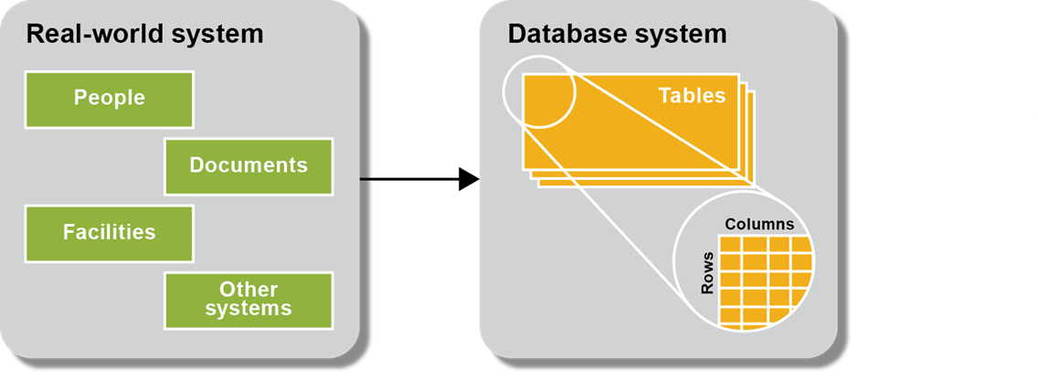
Basic steps for Designing a Data Structure
This illustration is a conceptual view of how the design of a data structure is based on a real-world system
It would permit you to see all the information about people, documents, within a real world system mapped to tables, columns and rows of a database system
As you design the data structure, each table represents on object or entity in a real-world system
Within each table, each column stores one item of information or an attribute for the entity
Each row stores one occurrence or instance of the entity

Slide 6
Six Basic Steps for Designing a Data Structure
Step 1: Identify the data elements
Step 2: Subdivide each element into its smallest useful components
Step 3: Identify the tables and assign columns
Step 4: Identify the primary and foreign keys
Step 5: Review whether the data structure is normalized
Step 6: Identify the indexes
A relational database system should model the real-world environment then map it onto a relational database system
A table in a relational database system represents an object, or entity in the real world
A table is used to store attributes associated with the entity
Each row represents one instance of the entity
To model a database, the relationships between the tables you use a technique called ER modeling

Slide 7
Characteristics of a Table
Rows contain data about an entity
Columns contain data about attributes of the entity
Cells of the table hold a single value; row column intersect is a cell
All entries in a column are of the same kind
Each column has a unique name within that entity or table
The order of the columns is unimportant
The order of the rows is unimportant
No two rows may be identical

Slide 8
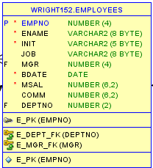
A Table Example
The EMPLOYEES table has details that describe the employee
These details should only be found once and only in one location in the database
Why?

Slide 9
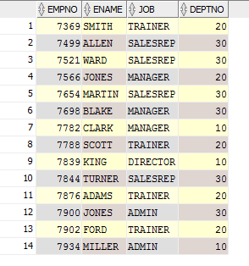
Sample EMPLOYEES Table Data
Look at rows in our EMPLOYEES table, does each row only occur once no duplicate data
All the entries in the columns are the same type of data
Is each column name unique to the table
Could I rearrange the order of the columns without affecting the table
Could the rows be in a different sequence or order
Does each cell contain a single value

Slide 10
Relationships
In a relational database, it is all about relationships
One entity or table stores data about employees
A second entity stores data about departments
A third entity stores data about courses
This method of storing data in different entities or tables minimizes the storing of redundant data (important concept)
These entities need to be connected; this requires relationships to be created
These are links to show how different records or rows of the entities are related
Relationships among different rows are established through key fields

Slide 11
Consider the Following …
CUSTOMER_ID | CUSTOMER_NAME | ADDRESS | PHONE | ZIP | ORDER_NO | ORDER_DATE | TOTAL_ORDER
2010 | Movers Inc. | 123 Park Lane | 212-555-1212 | 10095 | 100 | 12/23/2007 | $500.00
2010 | Movers Inc. | 123 Park Lane | 212-555-1212 | 10095 | 102 | 7/20/2008 | $100.00
2010 | Movers Inc. | 123 Park Lane | 212-555-1212 | 10095 | 103 | 8/25/2008 | $400.00
2010 | Movers Inc. | 123 Park Lane | 212-555-1212 | 10095 | 104 | 9/20/2008 | $200.00
2011 | Acme Mfg. Ltd | 555 Broadway | 212-566-1212 | 10004 | 105 | 9/20/2008 | $900.00
2012 | ALR Inc. | 50 Fifth Ave. | 212-999-1212 | 10010 | 101 | 1/5/2008 | $600.00
Is there any issue with mixing CUSTOMERS data with ORDERS data in the same structure?
Table is to contain data on one subject, does this violate that principle

Slide 12
Consider the Following …
Primary Key
CUSTOMER_ID | CUSTOMER_NAME | ADDRESS | PHONE | ZIP
2010 | Movers Inc. | 123 Park Lane | 212-555-1212 | 10095
2011 | Acme Mfg. Ltd. | 555 Broadway | 212-566-1212 | 10004
2012 | ALR Inc. | 50 Fifth Ave | 212-999-1212 | 10010
Foreign Key
ORDER_ID | CUSTOMER_ID | ORDE_DATE | TOTAL_ORDER
100 | 2010 | 12/23/2007 | $500
102 | 2010 | 7/20/2008 | $100
103 | 2010 | 8/25/2008 | $400
104 | 2010 | 9/20/2008 | $200
105 | 2011 | 9/20/2008 | $900
101 | 2012 | 1/5/2008 | $600

Slide 13
Consider the Following …
The previous slide now shows two tables, one for the CUSTOMERS details and a second one for the ORDERS details
This reduces the redundancy we had initially
Now the data only appears in one table instead of repeating values in the ORDERS /CUSTOMERS table we had initially
This is the beginning of a process known as NORMALIZATION, removing redundancies

Slide 14
Key Fields
There are two main types of key fields in a relational database:
Primary Key
Foreign Key
The primary key can be referred to by other names through its development
Surrogate Key
Composite Key

Slide 15
Primary Keys
Primary key
Value must be unique for each record
Serves to identify the record
Present in every record
Cannot be NULL (here is that word again)
Works best if it is a numeric field, any idea why?

Slide 16
NULL Value
A “NULL value” is the absence of a value, or, more exactly, it is defined as an unknown value to the database
A primary key must have a known value, you cannot omit its value
We have visited NULL values several times in SQL already
For now, it is important to realize that the primary key must have a unique value, and you cannot omit the value

Slide 17
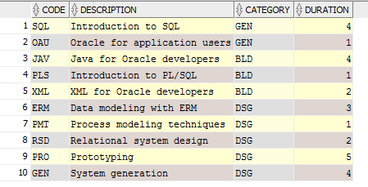
Primary Key – Entity Integrity
We did state previously that a primary key works best if it is a numeric value, but there is no reason why it cannot be a character value as it is displayed here.
Cannot generate its value or increment the value

Slide 18
Surrogate Key
Created to be the record’s primary key when no suitable candidate key exists for the primary key
A surrogate key has no real relationship to the record to which it is assigned, other than to identify the record uniquely
Developers configure the database to generate surrogate key values automatically
In an Oracle database, you can automatically generate surrogate key values using a special object called a sequence
They must always be numeric, since the database generates surrogate key values automatically by incrementing an integer value by one for the next value
As it turns out most of the primary keys are surrogate values
Think of your student number here at Humber. Where did it come from?

Slide 19
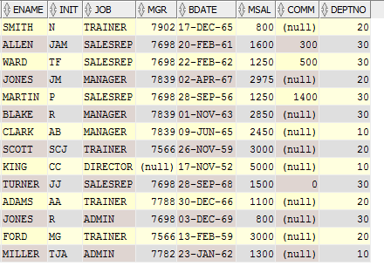

Surrogate Key
Look at the data on the left. What value in this part of table of data uniquely defines each row table?
Does one really exist that can be used?
What do you do? You create what is called a surrogate key value to represent each row of data since it does not occur naturally in the data. Hence the EMPNO is added to the table.

Slide 20
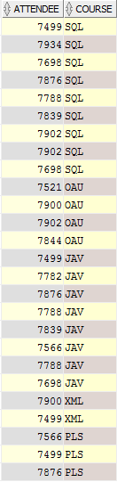

Foreign Key
A field in a table that is a primary key in another table
A Foreign key creates a relationship between the two tables
The Foreign key value must exist in the table where it is a primary key
Each attendee in REGISTRATIONS
Exists as an empno in the EMPLOYEES
In this schema the ATTENDEE column in REGISTRATIONS contains the values that correspond to the EMPNO value in the EMPLOYEES table
The values could have the same name, or they could be different as they are in this case

Slide 21
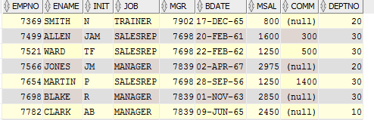
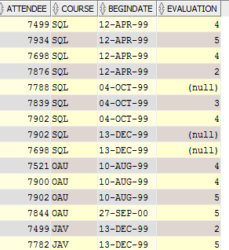
Foreign Keys
Relationship, ATTENDEE in RELATIONSHIPS table must exist as EMPNO in the ENPLOYEES table

Slide 22
Composite Key
A unique key created by combining two or more fields
Usually composed of fields that are primary keys in other tables
On the next slide the REGISTRATIONS table is a special table called a “linking” or a “bridging” or an “intersect” or a “connecting” or an “associate” table, can go by several names
It contains values from EMPLOYEES and the OFFERINGS tables
It removes a many-to-many relationship that would have existed between EMPLOYEES and the OFFERINGS tables

Slide 23

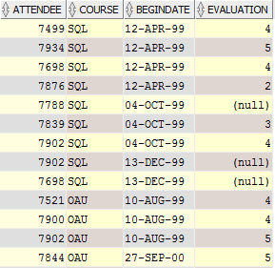
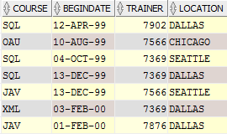
Composite Key
Composite Primary Key
Foreign Keys for REGISTRATIONS table are ATTENDEE and COURSE
They connect the EMPLOYEES table and the OFFERINGS table

Slide 24
Primary Key Development
The primary key plays a very important role in the relational database environment
We need to look at the primary key in more detail
This discussion will also touch on the surrogate keys in more detail
The role of “keys” is based on a concept known as determination
Example: If I know the value of EMPNO in the EMPLOYEES table, I should be able to look up or determine the employee’s name, initial, job, manager, birthdate, salary, commission, or department

Slide 25
Primary Key Development
The primary key plays a very important role in the relational database environment
We need to look at the primary key in more detail
This discussion will also touch on the surrogate keys in more detail
The role of “keys” is based on a concept known as determination
Example: If I know the value of EMPNO in the EMPLOYEES table, I should be able to look up or determine the employee’s name, initial, job, manager, birthdate, salary, commission, or department

Slide 26
Tables
As we’ve discussed, the most popular and widely used form of the database is the relational database
In this type of database, data is stored in tables
Both the user data and the metadata are stored as tables
Another word for a table is relation, a 2-dimensional table that has certain characteristics
Each row of a table holds data that pertains to an entity or some portion of an entity. The rows of a STUDENTS relation would contain data about one student
Columns contain data about attributes of the entity
What is metadata?
Simply “data about data”, who owns the table, where is it stored, what type of data is used for columns, what columns exist, this is all metadata, or data about the data

Slide 27
Characteristics of a Relational Table
All values in a column must have the same data format. If it is a NUMBER data format, all values assigned to that attribute must be numbers
Each column has a specific range of values called the attribute domain
The order of the rows and columns does not matter
By definition, a table cannot have duplicate rows. Each table must have an attribute or combination of attributes (Primary Key) that uniquely identifies each row

Slide 28
Entities and Instances
Entities have instances (just as classes do)
An instance is one occurrence of an entity, one specific entity
The customers table has rows of data or instances of the customers’ entity

Slide 29
Entity or Table Definitions
If you were to develop a database for a multi-player game what do you need to store for the game?
These things you need to store for later use are the entities or tables
A noun, examples: objects, players, locations, weapons
All entities are nouns, though not all nouns are entities
A thing of significance about which the business needs information, at a snapshot in time
Anything about which data are to be collected and stored
It is possible to have hundreds, perhaps even thousands, of different entities or tables
This largely depends on the information that needs to collected and stored

Slide 30
Attribute Definitions
Attributes are the columns of the table
Attributes describe the entity
They are specific pieces of information that need to be known about the entity
An attribute is a property of the entity, a detail about the entity
Attributes describe, quantify, qualify, classify, and specify an entity

Slide 31



Attributes
The following attributes are being used to describe the following entities,
Employees:
Registrations:
Offerings:

Slide 32
Data Modeling
The purpose of data modeling is to develop an accurate model or graphical representation of the client’s information needs and business processes
The data model acts as a framework for the development of the new or enhanced application
Entity Relationship modeling is independent of the hardware or software used for the implementation
Entity Relationship modeling is strongly connected to the relational database

Slide 33
Determine Entities
Start the Entity Relationship Model by determining the Entities
In the documentation, find the main nouns (people, places, things) that are the business objects
These become Entities
Entities usually become tables

Slide 34
Attributes vs. Entities
Entity Characteristics | Attribute Characteristics
A thing about which information must be stored | Qualifies or describes an entity Qualifying it, Identifying it, Classifying it, Quantifying it, Expressing its state
Possesses one or more attributes. If there are no attributes, it is not an entity | Does not possess attributes of its own. If it has attributes, then it may actually be an entity, or a combination of misnamed attributes
May have multiple occurrences and must be associated with another entity by a relationship | Has a single value for each entity instance Names for attributes should be clear and not ambiguous

Slide 35
What to Look for in an Attribute
Find the attributes, the nouns that describe each entity
Decompose each attribute to the level needed by the business
Verify Single Value – multiple valued attributes have either a missing attribute or a missing entity. Resolve these
Verify No Attributes that have Attributes – if there are, an entity is missing
Verify No Derived Data – only data should be stored. Totals, averages, etc. can be calculated when needed

Slide 36
Finding Attributes
Attributes may appear in documentation as:
Descriptive words and phrases or nouns
Prepositional phrases (salary amount for each employee)
Possessive nouns and pronouns (employee’s name)
Questions to ask the user
What information do you need to hold about the entity?
What information do you need displayed or printed about an entity?
Is this attribute really needed?
What level of detail (decomposition) do you need?

Slide 37
Determining Relationships Between Entities
Relationships also represent something of significance to the business
They express how entities are mutually related
Relationships always exist between two entities (or one entity twice)
A relationship connects two entities
Relationships always have two perspectives
Relationships are named at both ends
A relationship represents a significant dependency between two entities – and always two entities
The way one entity relates to another
The business rules that link together business information needs
What one thing has to do with another
A named association between entities

Slide 38
Diagramming Conventions
Component | Description
Name | A description of the business rule or relationship name associating the entities, for example ‘taught by’ or ‘assigned to’
Optionality | The business rule which indicates whether the relationship must always exist or if it need not exist for every instance of the entity, optionality is also known as minimum cardinality
Degree | The business rule that indicates how many of these relationships may exist, either one and only one or many. You can refer to the degree as maximum cardinality. If you identify a relationship which could have a degree of zero, then it is an optional relationship

Slide 39
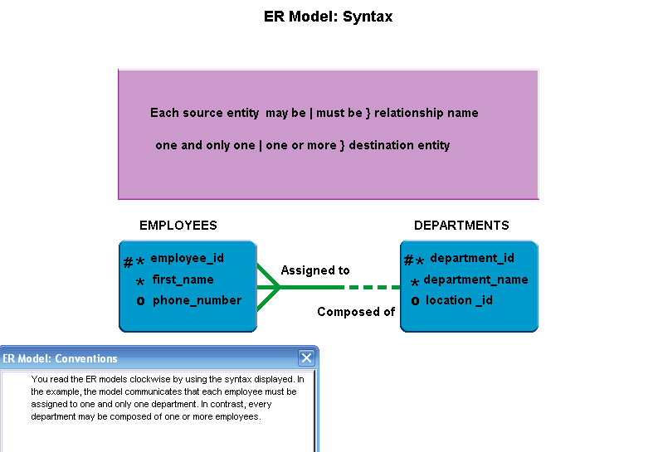
Relationship Syntax

Slide 40
Relationship Types
Many-to-one – these are the most common, and show that a relationship has a degree of one or more in one direction and only one in the other direction
Many-to-many – these are also very common, particularly in the initial stages of creating a model. There is a degree of one or more in both directions. They are usually optional in both directions
One-to-one – there is a degree of one and only one in both directions. These are quite rare as they usually indicate the two entities are really the same entity in business terms

Slide 41
Practical Example
We will now look at an invoice
This invoice has many data elements
We need to look at the document to determine the information it contains
You should be able to see the following (look for it)
Details on three different entities
Vendors
Invoices
Invoice Line items

Slide 42
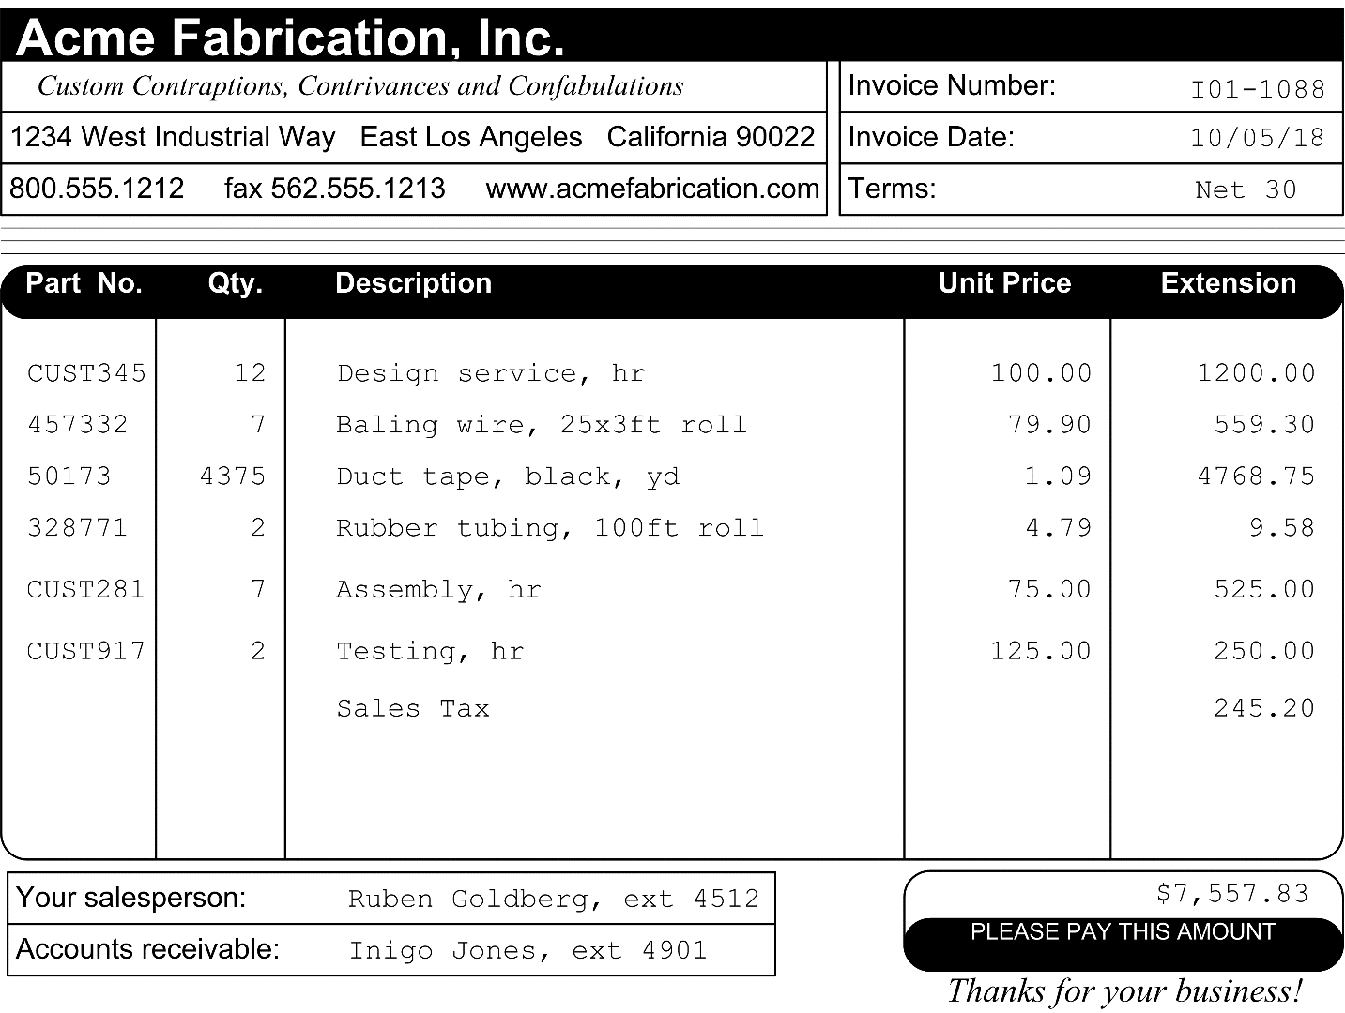
An Invoice
What data elements can you see
Depending on the nature of the system, you can identity data elements in a variety of ways
You could interview users, analyze existing systems
You can view inputs and outputs from systems to determine elements
This invoice is an output from a system
It contains elements that could come from different entities
What elements do you see?

Slide 43
Data Elements on the Invoice
Vendor name Item quantity
Vendor address Item description
Vendor phone number Item unit price
Vendor fax number Item extension
Vendor web address Vendor sales contact name
Invoice number Vendor sales contact extension
Invoice date Vendor AR contact name
Invoice terms Vendor AR contact extension
Item part number Invoice total

Slide 44
Identifying Elements
As you identify elements you should also think about which entities the elements would be associated with
This will help to identify the tables of the database later on

Slide 45
How to Subdivide Data Elements
Some data elements you define in he design process will consist of multiple components
The next step is to divide these elements into their smallest useful values
The first example is to take the sales contact for a vendor, it is showing the full name
This should be divided into two elements, a first name and a last name
When the name is divided you can easily perform sorting operations on the last name or first name
When it is in a full name you would need to use functions to extract the first or last name to isolate it
Similar to other fields like an address, it should be divided into its smallest components too
A phone number could be divided into 4 fields, area code, exchange code, the 4-digit number and an extension, not usually done though
Data elements should be in their smallest useful parts
You can always CONCAT the values together if required, easier then parsing the values into smaller values

Slide 46
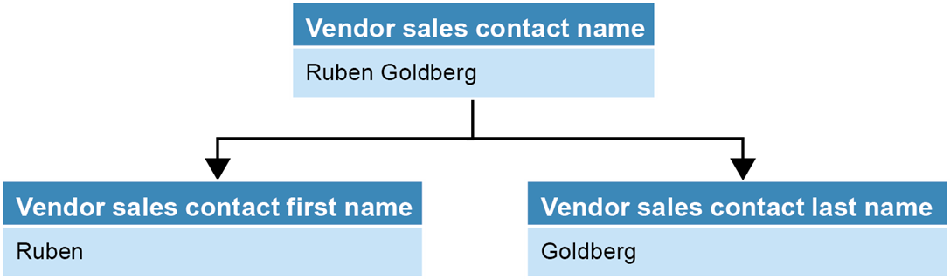
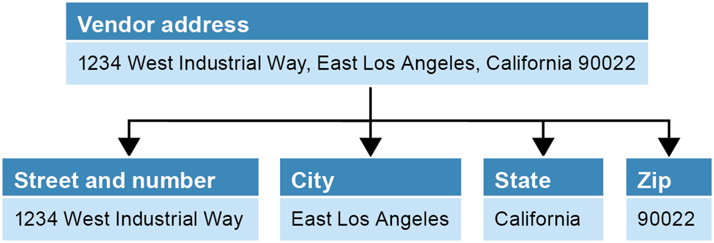
How to Subdivide Data Elements
Example of dividing an address into its smallest components
This should be done regardless
Examples of dividing the vendor sales contact name into its smallest parts

Slide 47
How to Identify Primary and Foreign Keys
Once the entities and the data elements of a system, the next step is to identify the relationships between the tables
To do this you need to identify the primary and foreign keys, the elements that establish the relationship between the entities
The vendor name could be used as a primary key value for the VENDORS table
Yes, it may be unique but it is long, not easy to enter, so an ID column like VENDOR_ID could be used
Advantage of an integer value is it can be incremented by one for each new row
You may consider the INVOICE_NUMBER column as the primary key for INVOICES, since this is an ACCOUNTS PAYABLE (AP) system, the invoice number is coming from the vendor so should create our own INVOICE_ID to represent the invoice

Slide 48
Identify Tables and Assign Columns
The next slide will show what columns might be added or removed from the initial invoice form we showed
As new elements are added you can remove elements that may not be needed

Slide 49
Identify Tables and Assign Columns
Vendors Invoice line items
Vendor AR last name Invoice number*
Vendor AR phone Item part number
Terms* Item quantity
Account number* Item description
Item unit price
Item extension
Account number*
Sequence number
Vendors Invoices
Vendor name Invoice number*
Vendor address Invoice date
Vendor city Terms*
Vendor state Invoice total
Vendor zip code Payment date
Vendor phone number Payment total
Vendor fax number Invoice due date
Vendor web address Credit total
Vendor contact first name Account number*
Vendor contact last name
Vendor contact phone
Vendor AR first name

Slide 50
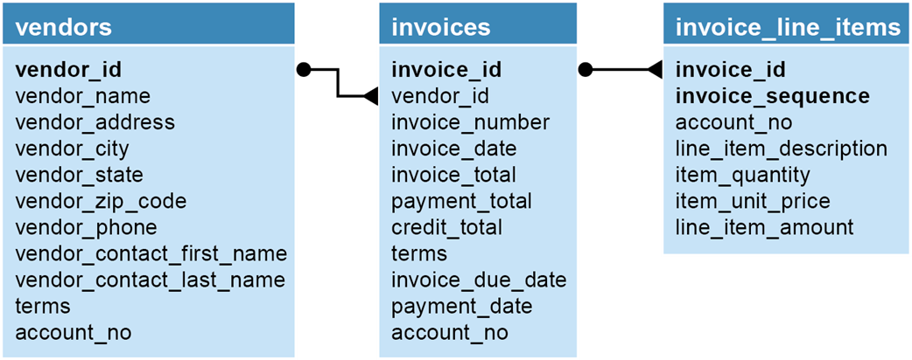
Tables with a One-to-Many Relationship
VENDOR_ID to represent the vendor details of the VENDORS Table
INVOICE_ID to represent the invoice details of the INVOICES Table
INVOICE_ID and INVOICE_SEQUENCE to represent each line of the INVOICE_LINE_ITEMS table, there can be more than one line item on the same invoice, this is an example of a composite primary key
This forms a one-to-many relationship between the tables

Slide 51
Tables with a Many-to-Many Relationship
Tables with a Many-to-Many relationship are not permitted in a relational database
Look at the example on the next slide
One employee can be on many committees
Each committee may have many employees, this is a many-to-many relationship, it has to be resolved
A third table called MEMBERHIPS has been created between the EMPLOYEES and COMMITTEES tables
This third table is called a LINKING table or a BRIDGING table or an INTERSECT table
It will contain the two primary key values of the two tables it links as its primary key, in this case the EMPLOYEE_ID and the COMMITTEE_ID columns become a composite primary key
The EMPLOYEE_ID and the COMMITTEE_ID columns together become the primary key for the MEMBERSHIPS table

Slide 52
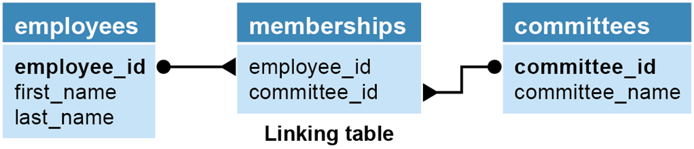
Tables with a Many-to-Many Relationship

Slide 53
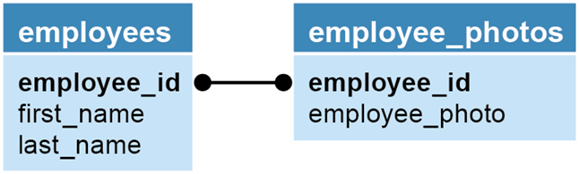
Tables with a One-to-One Relationship
One-to-many relationships do not occur that frequently
A one-to-one relationship also that the elements of both tables could also be in the same table
In the example below, the EMPLOYEE_PHOTO could also be a column in the EMPLOYEES table

Slide 54
Enforcing Relationships Between Tables
A Primary key to a foreign key relationship can be enforced by creating a foreign key constraint to link the two table columns together
This is called referential integrity
It ensures the value entered as a foreign key in a related or child table exists as a primary key value in the parent table
A relational database does not allow child values to be orphaned, a child with out a parent

Slide 55
Enforcing Relationships Between Tables
Deleting a row from the primary key table
If the foreign key table contains one or more rows related to the deleted row
Inserting a row in the foreign key table
If the foreign key value doesn’t have a matching primary key value in the related table
Updating the value of a foreign key
If the new foreign key value doesn’t have a matching primary key value in the related table
Updating the value of a primary key
If the foreign key table contains one or more rows related to the row that’s changed
These are situations where referential integrity would be violated

Slide 56
Terms to Know About Data Structures
Entity
Attribute
Instance
Entity-relationship (ER) modeling
Referential integrity
Declarative referential integrity (DRI)
Foreign key constraint
Orphaned row

Slide 57
How Normalization Works
The next step in the design process is to review whether the data structure is normalized
To do this, we look at how the data is separated into related tables
Steps 1 through 4 will give us a partially normalized database
The next slide will show us an unnormalized data structure

Slide 58
The First Three Normal Forms
Normal form Description
First (1NF) The value stored at the intersection of each row and column must be a scalar value, and a table must not contain any repeating columns.
Second (2NF) Every non-key column must depend on the entire primary key.
Third (3NF) Every non-key column must depend only on the primary key.
Note
Most designers stop at the third normal form.

Slide 59
The Next Four Normal Forms
Normal form Description
Boyce-Codd (BCNF) A non-key column can’t be dependent on another non-key column.
Fourth (4NF) A table must not have more than one multivalued dependency, where the primary key has a one-to-many relationship to non-key columns.
Fifth (5NF) The data structure is split into smaller and smaller tables until all redundancy has been eliminated.
Domain-key (DKNF) Every constraint on the relationship is or dependent only on key constraints and Sixth (6NF) domain constraints, where a domain is the set of allowable values for a column.

Slide 60
The Benefits of Normalization
More tables, and each table has an index on its primary key. That makes data retrieval more efficient.
Each table contains information about a single entity. That makes data retrieval and insert, update, and delete operations more efficient.
Each table has fewer indexes, which makes insert, update, and delete operations more efficient.
Data redundancy is minimized, which simplifies maintenance and reduces storage.

Slide 61
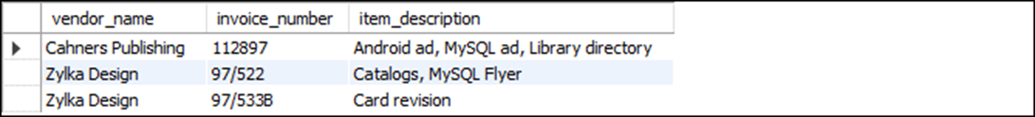
First Normal Form
This figure shows one row for each vendor with several values for the Item_Description
This is not in First Normal Form since it contains repeating values

Slide 62
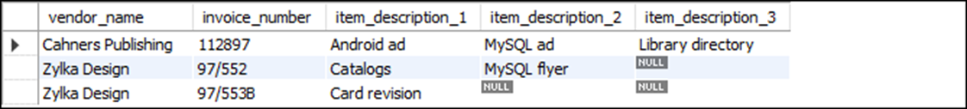
First Normal Form
This table also displays repeating columns
Only difference it there are multiple columns instead of values being displayed in a single column
Repeating values in a table are not permitted so this table is unnormalized
Notice Invoice_Description 1, Invoice_Description 2, Invoice_Description 3 these are repeating values
These are not allowed

Slide 63
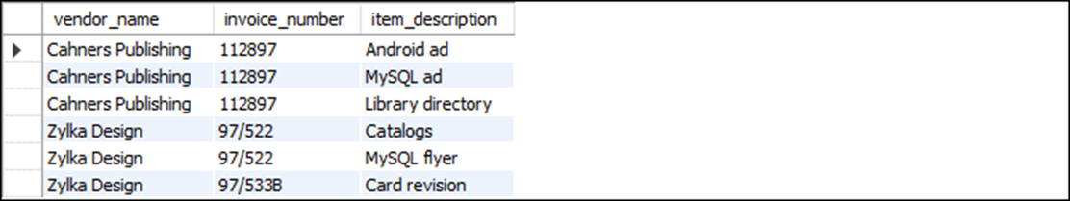
First Normal Form
The structure on the previous slide can be rewritten so there is no repeating values
Need a new primary key value to give a unique value
Repeating values have been eliminated
The vendor name and the invoice number are repeating
We now have vendor name and invoice number been repeated multiple times
This can be rectified by moving to the second normal form

Slide 64
First Normal Form
For a table to be in first normal form, its columns must not contain repeating values
Instead each column must contain a single, scalar value
In addition, the table must not contain repeating columns that represent a set of values
A table in first normal form often has repeating values in its rows
This can be resolved by going to second normal form

Slide 65
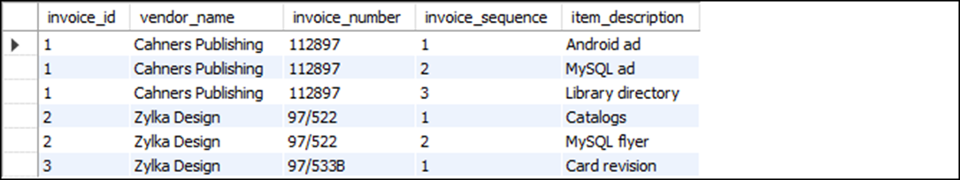
First Normal Form
Once a structure is in first normal form an a additional column can be added as a primary key
We mentioned previously about using an integer value as a primary key
This value can then be incremented
It is also shorter and has less chance of being entered incorrectly
The invoice sequence column was also added so the item description did not need to be part of the primary key value
So the primary key is INVOICE_ID with INVOICE_SEQUENCE

Slide 66
Second Normal Form
There are three values that are not part of the primary key
These are VENDOR_NAME, INVOICE_NUMBER and ITEM_DESCRIPTION
We need to determine which part of the primary key these values depend on
VENDOR_NAME and INVOICE_NUMBER only depend on the INVOICE_ID part of the key
The ITEM_DESCRIPTION requires both the INVOICE_ID and INVOICE_SEQUENCE as dependents

Slide 67
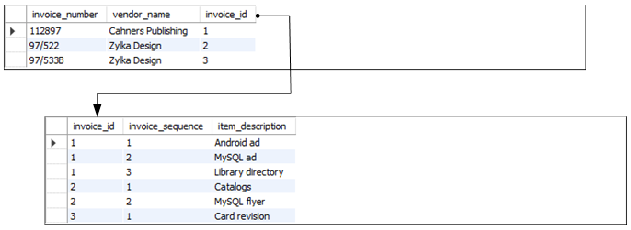
Second Normal Form
The INVOICE_ID and its dependent values will form a new table
The original INVOICE_ID and SEQUENCE_ID will form the primary key of a second table
So the one table we had now becomes two tables
By applying the second normal form some of the redundant data that existed is eliminated

Slide 68
Second Normal Form
For a table to be in second normal form, it must be in first normal form
All attributes within the entity should depend solely on the unique identifier of the entity.
To apply second normal form, you move columns that do not depend on the entire primary key to another table and establish a relationship between the two tables
Second normal form helps remove redundant row data, which can save storage space, make maintenance the chance of storing inconsistent data

Slide 69
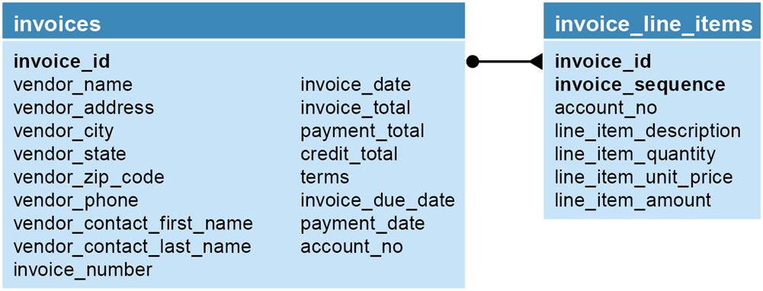
Third Normal Form
To apply the third normal form you make sure every non-key column depends only on the primary key
Initially we have expanded the columns definitions for INVOICES and for INVOICE_LINE_ITEMS
Below you will see the expanded definitions, both have the same primary keys

Slide 70
Third Normal Form
Answer this question, does the VENDOR information depend only on the INVOICE_ID
Could ask it this way, will the information for the same vendor change from one invoice to another
If the answer is NO
Then the vendor information should be stored in a separate table
This way you can be sure the vendor information for each invoice will be the same
This will also reduce redundancy of the data in the INVOICES table

Slide 71
Third Normal Form
Other questions to ask …
Does the vendor information (vendor_name, vendor_address, etc.) depend only on the invoice_id column? (already addressed)
Does the terms column depend only on the invoice_id column?
Does the account_no column depend only on the invoice_id column?
Can the invoice_due_date and line_item_amount columns be derived from other data?
The other details here depend on the expanded definition of our tables.

Slide 72
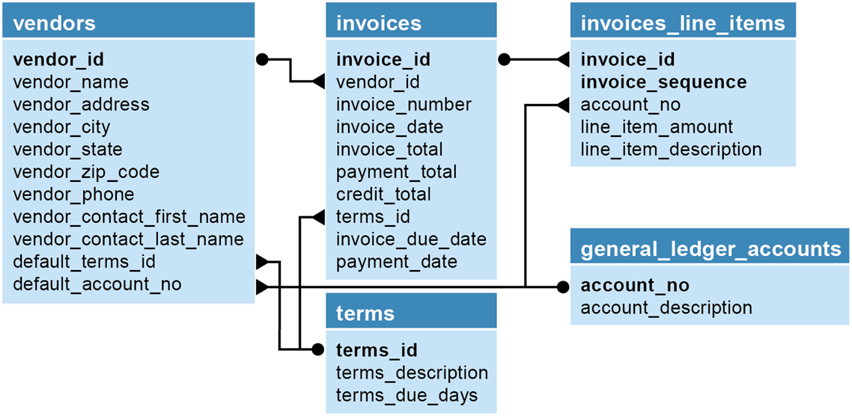
Third Normal Form

Slide 73
Third Normal Form
For a table to be in third normal form, it must be in second normal form
Every non-key column must depend only on the primary key
If a column does not depend only on the primary key, we have a TRANSITIVE DEPENDANCY
This data will ten become a new table and a value will be remaining so there is a relationship to the original table

Slide 74
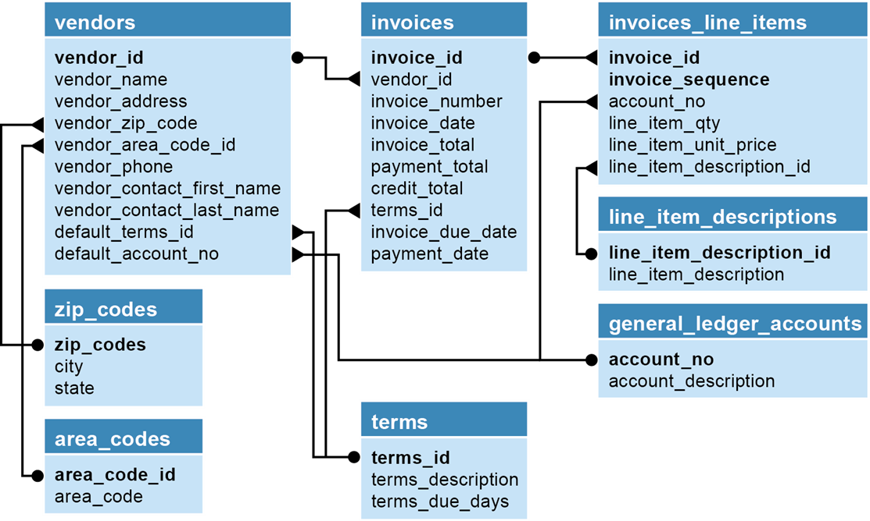
Normalization
In business it is generally acceptable to normalize to the third normal form
This is sufficient for business applications
There are 6 normal forms
Here is the AP database we have worked with normalized to the 5th normal form
Notice the addition of additional tables
WE will only normalize to the 3rd normal form

Slide 75
Using MySQL Workbench
MySQL Workbench can be used to design a relational schema
There are few slides here to document the process
There is a PDF document posted to further explain the process
The lab today will have you create a small schema

Slide 76
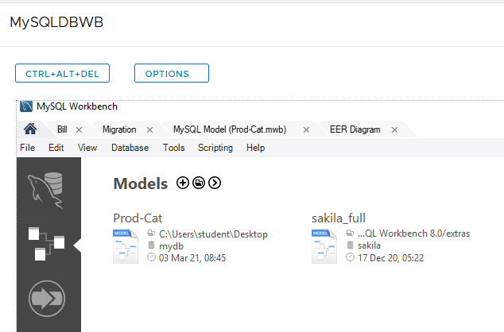
Open MySQL Workbench
After you open MySQL Workbench, click the Home icon on the left side
Then click the + (plus sign) beside Models

Slide 77
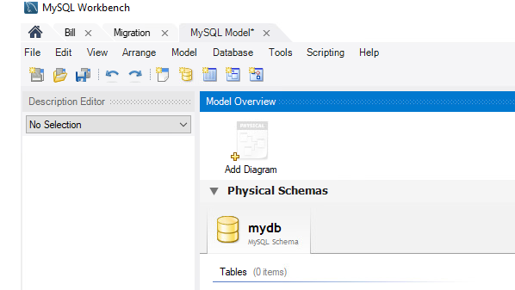
Add a Diagram
Double-click the Add Diagram icon

Slide 78
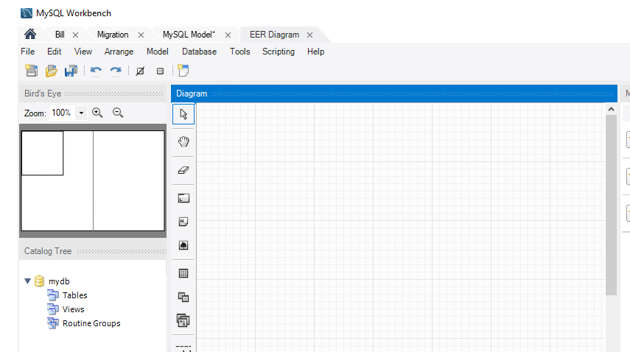
Diagram Area
This will open the area where you can design the EER

Slide 79

Toolbar
The toolbar shows you the various objects you can create
You can create Tables
There are several different relationships
These depend on the cardinality, 1-M, 1-1 or even N-M
The also show optionality or whether a relationship is mandatory or optional

Slide 80
Steps
Decide what you want to diagram before you diagram your schema
Use paper and work through the details for each question
Each question will give you details about the design of the database
The exercises are quite small, not too many tables
They will get you started
This is one method to begin database design, using a narrative

Slide 81
Today’s Lab
We will introduce you to MySQL Workbench to create a database diagram
There are a few questions that we will shown to you and you will have to design the database according to the requirements

